Slide 1


Mediation through a Spanish radio show in podcast format
Sara Bueso Ariño
Sara.BuesoArino@xjtlu.edu.cn
2024/02/20
Notes:
English Title: Uppercase, Calibri size 60, XJTLU Navy
English Subtitle: Uppercase, Calibri size 36, XJTLU Navy

Slide 2
index
Implementation context
Observations at the beginning of the AY2022-23 – S1
S1: Preparing the way to mediation.
S2: Beginning.
S2: Mediation.
Results
2

Slide 3
Implementation Context:
International business with a language (IBWL)
Spanish language pathway (2021-2025).
AY 2022-2023 – S2
Last academic year of the old curriculum and the old assessment components and their descriptors.
Y4
Y3
SPA307
SPA205
Y2
SPA103
Y1
SPA001 + SPA002
B1
B2
A1
A2
Independent user
Basic user
3

Slide 4
Observations at the beginning of the AY2022-23 - S1
Negative impact of pandemic:
Quantitative observations in Y2 Speaking CW:
Qualitative observations:
Anxiety: fear, tension and lack of self-confidence.
Belief of not being able to perform any tasks satisfactorily (especially speaking skills tasks).
Low self-esteem.
Belief: “Spanish is very difficult” (linguistic distance).
Lack of motivation and commitment.
 | AY19-20 | AY20-21 | AY21-22
Average mark | 41% | 56.6% | 55.5%
Absentee rate (average) | 6.4% | 8.2% | 7.5%
Failure rate | 23% 14% | 35.5% 24.5% | 31% 36%
Notes:
Mencionar año dos_ year 2 students. Ye

Slide 5
S1: PREPARING THE WAY TO MEDIATION
Challenge:
Student’s affective relationship with their learning of Spanish.
A new approach to Speaking coursework and Writing coursework assessment components.
Student's self-esteem and self-confidence.
improve
Design these assessment components as an opportunity to EMPOWER the student through a VIRTUAL ROLE OF (INTER)CULTURAL MEDIATOR.
Student’s affective relationship with (some) assessment components.
5
Notes:
How to tackle this challenges: design these assessment components as an opportunity to empower the student through a virtual role of intercultural mediator / creator.
Integrated these 2 assessment components.

Slide 6
S1: PREPARING THE WAY TO MEDIATION
New approach to Speaking and Writing coursework:
ONE PODCAST EPISODE
Prepare podcast script
Speaking CW – Task 1: ONE PODCAST EPISODE
STUDENT must:
(on week 13)
Record and edit the podcast episode
STUDENT needs: training for their Speaking CW podcast
Script part
Recording and editing part
TEACHER CHALLENGES: guide the student in the training of podcast creation
6

Slide 7
S1: PREPARING THE WAY TO MEDIATION
Affective relationship with their learning process
Challenge: improve
Self-esteem & self-confidence
Affective relationship with assessment components
WORK IN PAIRS - Cooperative learning:
Task 1: script 1
marks (√)
improvement feedback
(after teaching unit 1)
Student receive:
Writing CW
Task 2: script 2
(after teaching unit 2)
Student feels in control of their marks
Positively influences their affectivity
Task 3: script 3
(after teaching unit 3)
7
Notes:
Resuming the issue

Slide 8
S1: PREPARING THE WAY TO MEDIATION
Student needs:
Teacher challenge:
Script part
Recording and editing part
Training of podcast creation
WORK IN PAIRS - Cooperative learning:
WRITING CW:
Task 1
Task 2
Task 3
SCRIPT TRAINING
RECORDING AND EDITING PODCAST TRAINING
Trial podcast
Trial podcast
Non-mandatory homework
Improvement feedback
Positively influences their affectivity
Student feels in control of the podcast task
8
Notes:
Resuming the issue

Slide 9
S1: PREPARING THE WAY TO MEDIATION
Getting familiar with the (inter)cultural mediator role
Spanish with chopsticks radio show: 2 episodes
RECORDING AND EDITING PODCAST TRAINING:
Task 1
Task 2
Task 3
WRITING CW:
script training
The ideal laowai to live in China
Finding love in China
Relevant people from today’s China
Trial podcast
Trial podcast
Through the radio show and its topics, the student begins to place himself/herself in that (inter)cultural mediating position.
9
Notes:
Resuming the issue

Slide 10
S2: beginning
The student's affectivity has improved in relation to:
  their learning process.
  self-esteem and self-confidence.
  some assessment components.
The student already knows how to create a podcast episode (script + recording and editing).
The student is already familiar with his/her role as (inter)cultural mediator.
10

Slide 11

S2: MEDIATION
The student in the role of
the HOST OF A RADIO SHOW
FOR Spanish-speakers
11

Slide 12
S2: MEDIATION
Integrated writing and speaking coursework
Speaking Coursework
TASK 1
TASK 2
TASK 3
1 SCRIPT
Task 1:
Writing
Coursework
HOSTING THEIR OWN SPANISH RADIO SHOW
(PODCAST)
Throughout Semester 2
12

Slide 13
S2: MEDIATION
In mediation, the user/learner acts as a social agent who creates bridges and helps to construct or convey meaning, sometimes within the same language, sometimes from one language to another (cross-linguistic mediation). The focus is on the role of language in processes like creating the space and conditions for communicating and/or learning, collaborating to construct new meaning, encouraging others to construct or understand new meaning, and passing new information in an appropriate form. The context can be social, pedagogic, cultural, linguistic or professional. (Council of Europe, 2018)
13

Slide 14
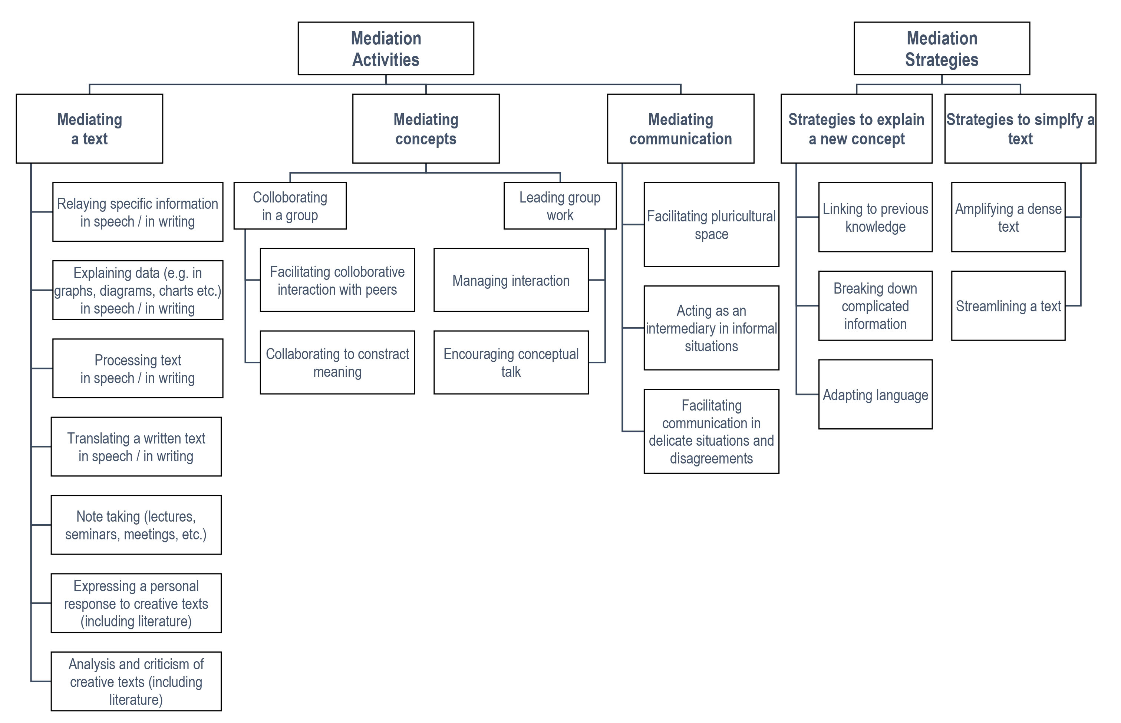
HOSTING A RADIO SHOW
FOR SPANISH SPEAKERS IN CHINA
14

Slide 15
S2: MEDIATION: FACILITATING PLURICULTURAL SPACE
SPANISH WITH CHOPSTICKS RADIO SHOW
[Facilitating pluricultural space] reflects the notion of creating a shared space between and among linguistically and culturally different interlocutors, i.e. the capacity of dealing with ‘otherness’ to identify similarities and differences to build on known and unknown cultural features, etc. in order to enable communication and collaboration. The user/learner aims to facilitate a positive interactive environment for successful communication between participants of different cultural backgrounds [...]. He/she aims to expand and deepen intercultural understanding between participants in order to avoid and/or overcome any potential communication difficulties arising from contrasting cultural viewpoints. Naturally, the mediator him/herself needs a continually developing awareness of sociocultural and sociolinguistic differences affecting cross-cultural communication. (Council of Europe, 2018)
15
Notes:
Poner en negrita palabras clave que me interesan.

Slide 16
S2: MEDIATION: FACILITATING PLURICULTURAL SPACE
SPANISH WITH CHOPSTICKS RADIO SHOW
Target audience: Spanish speakers living in China.
The language barrier makes it difficult for this audience to access and integrate into Chinese culture and society.
Purpose of the radio show:
  To bring Chinese culture and society closer to this audience through Spanish language.
  To facilitate the audience's understanding of China.
  To improve the communication and relationship of this Spanish-speaking community with Chinese society.
16

Slide 17
S2: MEDIATION
Integrated writing and speaking coursework
CONTEXT:
This last radio episode is titled: A Happy and Balanced Life in Suzhou. On the occasion of the end of the COVID restrictions and the return to normality, more and more foreigners are returning to China and, among them, many Spanish speakers. Therefore, this last episode is dedicated to all these Spanish speakers who return to China or who come for the first time. These are the structure and the topics the podcast episode should cover:
Opening, greeting and welcoming the listeners.
To whom is this last episode’s addressed, and why?
Section 1: How to have Feng Shui home.
Section 2. An unforgettable weekend in Suzhou.
Section 3. Leading a healthy life according to traditional Chinese medicine.
Closing the episode and farewell the listeners.

Slide 18
S2: MEDIATION
Preparing the podcast episode: LINGUISTIC Mediation activities
Feng Shui.
Your Feng Shui home.
Section 1: How to have a Feng Shui home.
Section 2. An unforgettable weekend in Suzhou.
Section 3. Leading a healthy life according to traditional Chinese medicine.
Suzhou city.
Suzhou Leisure Guide.
Chinese traditional medicine.
Eat and Live Healthy.

Slide 19
S2: MEDIATION
Preparing the podcast episode: LINGUISTIC Mediation activity 1
Some listeners of our radio show have contacted us through our email (espanolconpalillos@xjtlu.edu.cn) to suggest a topic dedicated to Feng Shui. Some of them have just arrived and/or returned to China. Therefore, they ask us for help to redesign the distribution of furniture in their apartments and houses. For this reason, some of them have sent us photographs of some of the rooms in their homes. Our job will be to refurnish these rooms with the same or other new furniture following the Feng Shui philosophy.
Section 1 of our podcast: How to have a Feng Shui home.
It has two parts:
Feng Shui (Preparation during lecture)
  Feng shui introduction.
  Feng shui purpose.
  Choose two rooms in the house and give advice to make them Feng Shui.
Your Feng Shui home (Seminar preparation: Writing CW – TASK 1).

Slide 20
20

Slide 21
S2: MEDIATION
Preparing the podcast episode: LINGUISTIC Mediation activity 1
Mediating a text -
Relaying information in speech / in writing.
Refers to the way some particular piece(s) of information of immediate relevance is extracted from the target text and relayed to someone else. Here, the emphasis is on the specific content that is relevant, rather than the main ideas or lines of argument presented in a text. Relaying specific information is related to Reading for orientation […] The user/learner scans the source text for necessary information and then relays this to a recipient.
(Council of Europe, 2018)

Slide 22
S2: MEDIATION
Preparing the podcast episode: LINGUISTIC Mediation activity 1
Strategies to explain a new concept -
Adapting language.
The user/learner may need to employ shifts in use of language, style and/or register in order to incorporate the content of a text into a new text of a different genre and register. This may be done through the inclusion of synonyms, similes, simplification or paraphrasing. (Council of Europe, 2018)

Slide 23
S2: MEDIATION
Preparing the podcast episode: LINGUISTIC Mediation activity 1
Lecture
WORK IN PAIRS - Cooperative learning:
1. Review of the structures to give advice that they already know.
2. Students are provided with a text about Feng Shui in Spanish and a template to help them extract and organize the relevant information.
3. Students read the text about Feng Shui in Spanish.
4. Each pair discusses the contents that they are going to include in their template.
5. Each pair fills out the template.
6. Each pair write the text of this part of section 1.
Mediating a text:
Strategies: adapting language
…some particular piece(s) of information of immediate relevance is extracted from the target text and relayed to someone else … The user/learner scans the source text for necessary information and they relays this to a recipient.
…through the inclusion of synonyms, similes, simplification or paraphrasing.

Slide 24
Results
Help them to improve their performance in the speaking skills
SPA103 | AY19-20 | AY20-21 | AY21-22
AVERAGE MARKS | 41 | 56,5 | 55,5
ABSENTEES RATE (AVERAGE) | 6,4% | 8,2% | 7,5%
FAILURE RATE (S1/S2) | 23% / 14% | 35,5% / 24,5% | 31% / 36%
AY22-23 (S1) | AY22-23 (S2)
77,6 | 73,4
2% | 6%
11,5% | 15%

Slide 25
Results
91.7% or 44/48
tentative survey
How would you rate the fact that both the Writing and the Speaking Coursework-Task 1 are related to each other?
91.7% or 44/48
How would you rate the process of preparing, writing, and giving feedback on the Writing Coursework throughout the semester?
Regarding motivation and engagement, how would you rate the topic on which the podcast activity is framed? (The presentation of Feng Shui, the city of Suzhou, and traditional Chinese medicine for Spanish speakers living in China)
85.5% or 41/48
83.3% or 40/48
How useful do you think the Podcast Assessment has been for your Spanish language learning?
Notes:
1. Useful/helpful or very useful/helpful.
2. Useful/helpful or very useful/helpful.
3. Motivating or very motivating.
4. Help me or help me a lot.

Slide 26
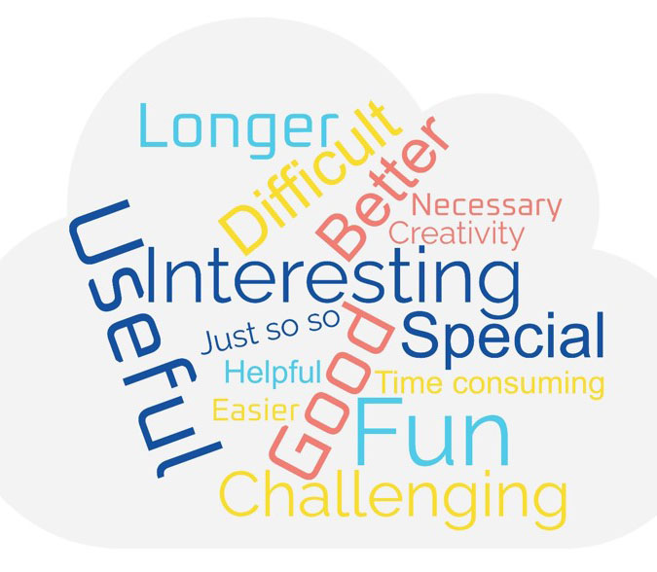
Results
tentative survey
Complete the sentence with your own words: “Compared to other Speaking Assessments that I have done in the past, the Podcast Assessment has been…”
…the Podcast Assessment has been very special and interesting.
…the Podcast Assessment has been creativity.
…The podcast assessment has been improved my speaking skill better
compared to other speaking assessment that I have done in the past.

Slide 27
Challenges for the future
AY2023-24
S2
Cross-linguistic mediation
AY2024-25
How to integrate Artificial Intelligence

Slide 28
Reference document
COMMON EUROPEAN FRAMEWORK OF REFERENCE FOR LANGUAGES: LEARNING, TEACHING, ASSESSMENT
COMPANION VOLUME WITH NEW DESCRIPTORS
(Council of Europe, 2018)

Slide 29

Contact information
Sara Bueso Arino Sara.BuesoArino@xjtlu.edu.cn

Slide 30

THANK YOU
Notes:
Title: Uppercase, Calibri size 60, XJTLU Navy

